Slide 1
GxP Enablement
Ruediger Partsch
Nils Hartmann
Jiss Nimmi Augustine
May 2026

Slide 2
Agenda
01
Overview about GxP
02
GxP Project Scope
03
GxP Solution Overview
..
04
On-going topics in GxP (eSignature and CGTO)
05
Contact Details

Slide 3
Overview
GxP* compliance provides regulations and guidelines to be followed during Manufacturing practice, Clinical Practice, Documentation Practice etc. covering aspects around patient safety, Product quality, and Data integrity.
Complying with GxP regulations is a legal requirement (e.g., by WHO, EMA, FDA) for all life science companies that develop, manufacture and distribute pharmaceuticals and medical devices.
There are two topics on-going under GxP topic.
eSignature integration for Purchase Order
S/4HANA extension for life science application
*GxP: Good Manufacturing Practice, Good Clinical Practice, Good Laboratory Practice, Good Documentation Practice etc

Slide 4
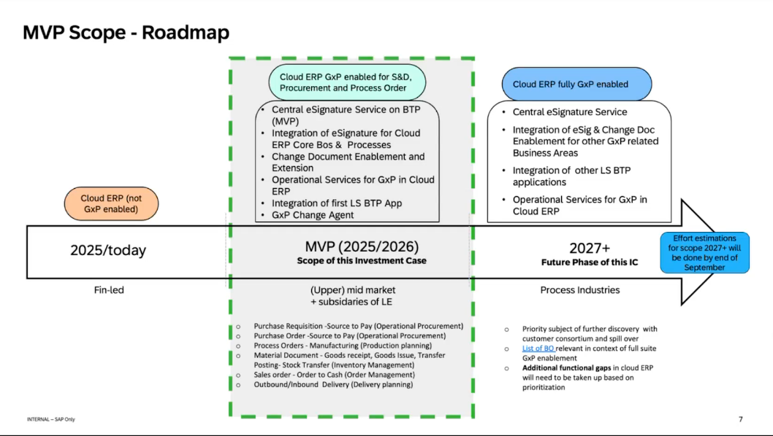
GxP Enablement – Project Scope

Slide 5
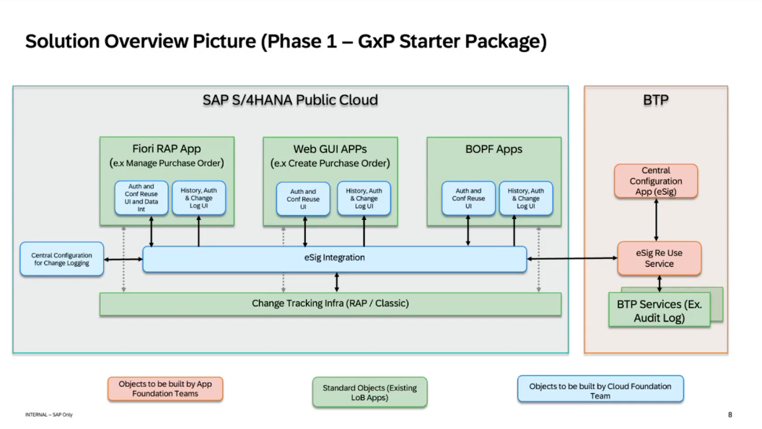
GxP Enablement – Solution Overview (Prototype)

Slide 6
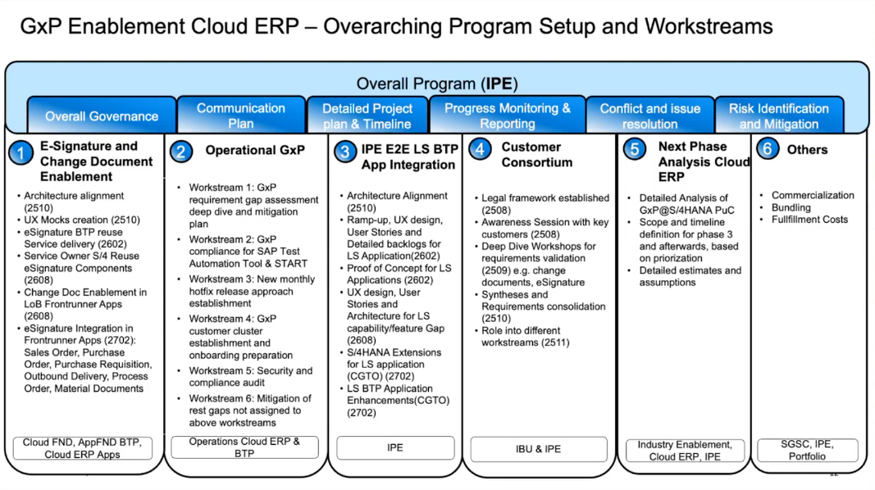
GxP Enablement – Project Setup

Slide 7
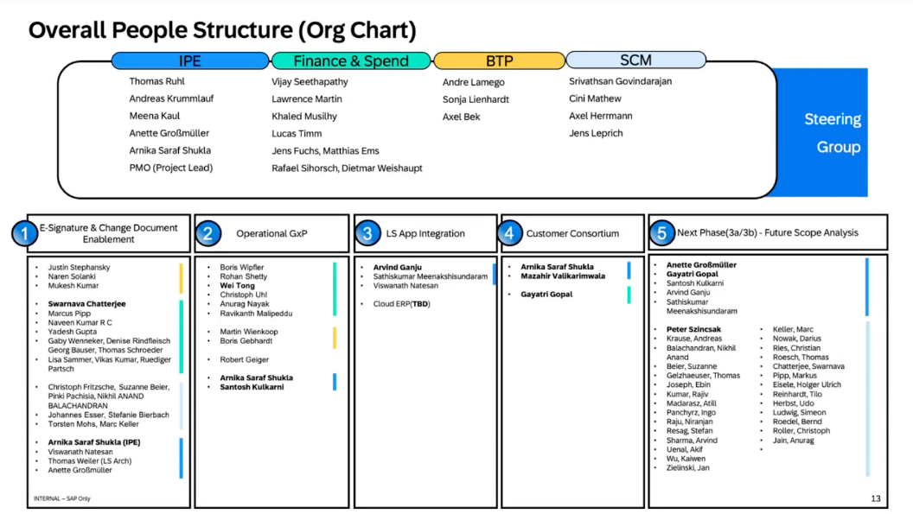
GxP Enablement – Contacts

Slide 8
eSignature (on-going Topic in GxP)
To make S/4HANA GxP compliant, we need to integrate eSignature Logs view in Fiori and Web GUI. We had few meetings to discuss the approach.
Purpose of eSignature:
To introduce the ability to capture eSignatures from Business Users including a Reason for Change, Notes (Free Text), Changed By, Changed on (Timestamp)as per the existing SAP Cloud Identity Service configurations of their SAP Landscapes.
To capture change documents for the relevant fields for the Business Objects.
eSignature is built on top of Change log concept. As a first step, we had to check whether change log is working fine for all relevant fields.
The details are available in the below wiki: https://wiki.one.int.sap/wiki/spaces/S4HPROC011/pages/5681941152/GxP+enablement
PO team had a meeting to discuss few of the points that they mentioned in ACD. MoM is attached

Slide 9
CGTO Enablement (POC phase)
Life Science customers of S4HANA Public Cloud will be able to operate and consume life science SaaS applications in their landscape seamlessly and executing end to end business processes transcending the solution boundaries.
CGTO would like to extend the LoB applications to support industry specific solutions, enrich LoB application UIs , enable integration necessary master and configuration data between the solutions, support business process integration (the transaction data should be exchanged) and seamless support to navigate related business entities hosted on different industry cloud applications.
The CGTO extension is already done in private cloud and they used the old style approach (The CGTO fields are embedded in core tables and used Badi to do the Crud operations).
In public cloud, they would like to try a different approach (Completely different Business Object)
CGTO ACD link
POC system: QJ6-001 (The training has to be completed before accessing their development)
Package: CGTO_S4HC_POC

Slide 10
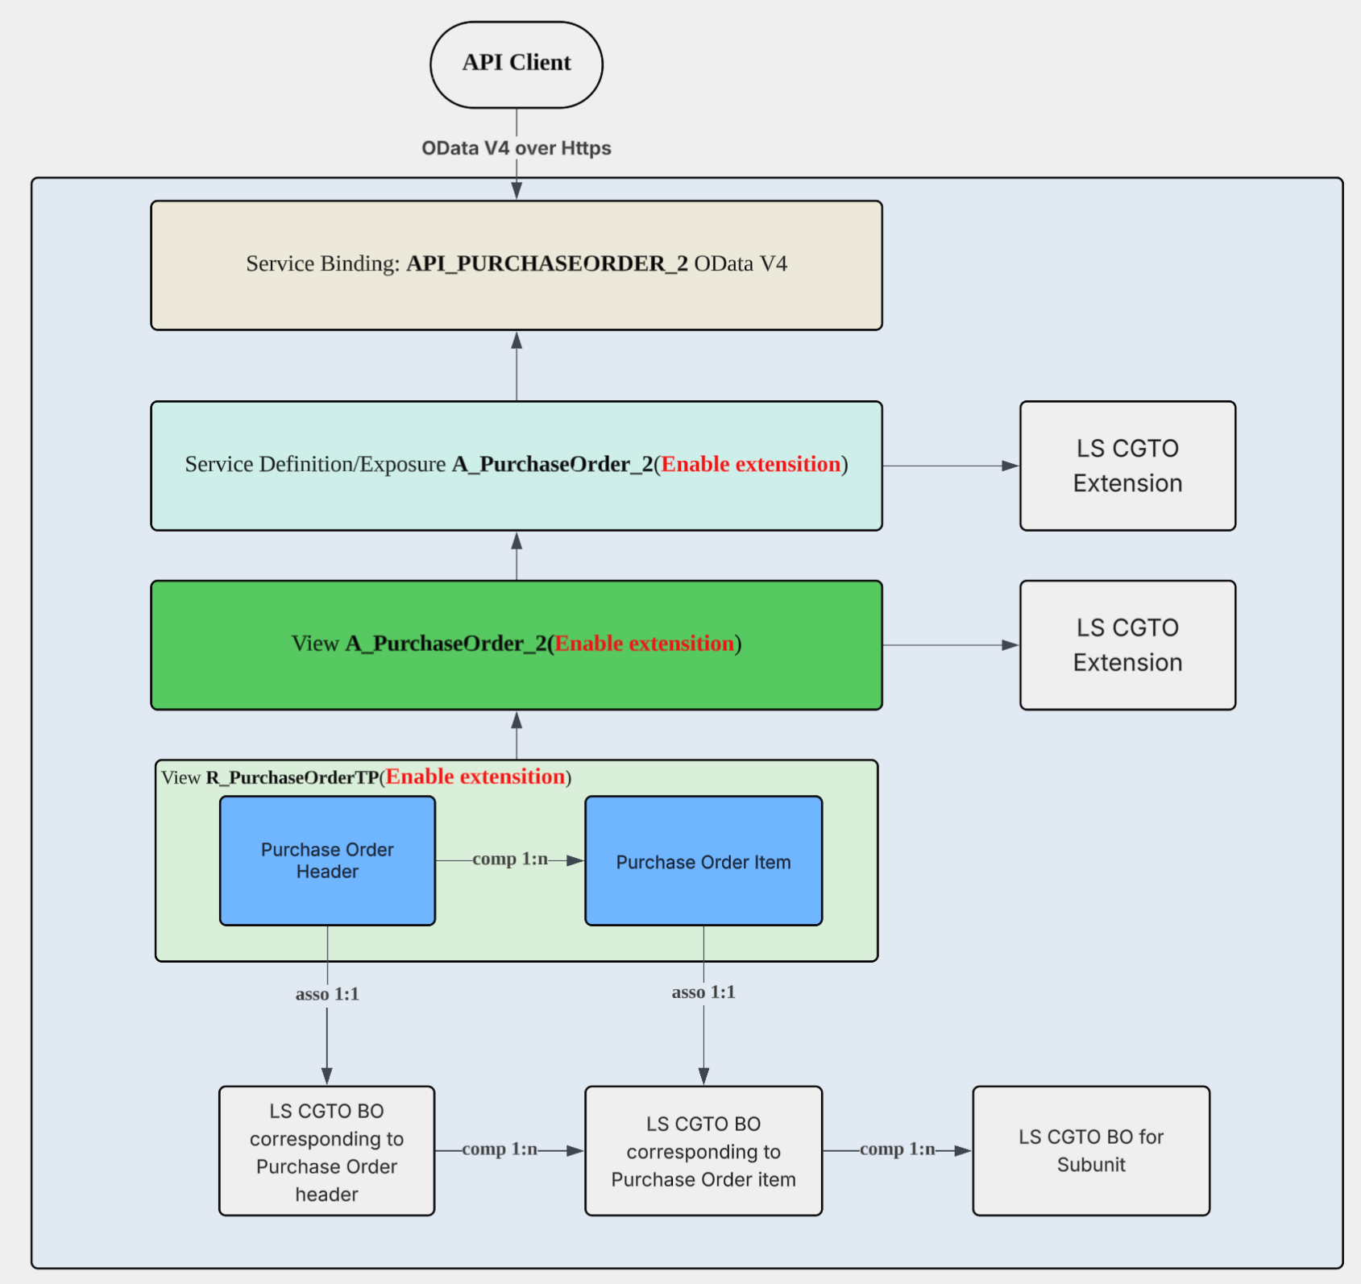
CGTO Enablement (POC phase) – API Extension
These changes are already delivered in CE2608. The oDATA V4 API is enabled for internal extensibility (without the Paas API extension) . Customer extensibility

Slide 11
CGTO Enablement (POC phase)
The latest meeting and the approach that they tried: Purchase_Order_Extension.pptx
Next Step: Nils will schedule a handover meeting with Lift & shift team and the CGTO POC team.
Aspect​ | Separate Extension BO (RAP)​ | Native Extension of Standard Tables​
Core idea​ | Custom RAP BO associated with PO via released APIs​ | Append fields directly to standard PO tables​
Clean Core alignment​ | ✅ Strong – no modification of SAP objects​ | ⚠ Weak – modifies SAP-owned tables​
Ownership clarity​ | ✅ Clear separation of SAP vs custom responsibility​ | ❌ Custom and standard responsibilities are mixed​
Implementation effort​ | ❌ Higher (BO modeling, associations, services)​ | ✅ Low (append + BAdI)​
Transactional coupling​ | ⚠ Limited / indirect​ | ✅ Strong (single LUW, native processing)​
Use of classic ABAP enhancements​ | ❌ Limited​ | ✅ Full (BAdIs, exits, determinations)​
1‑to‑1 field extension​ | ✅ Supported​ | ✅ Supported​
1‑to‑N extension capability​ | ✅ Fully supported (own tables, compositions)​ | ❌ Not supported (append fields only)​
Data model flexibility​ | ✅ High (own persistence, lifecycle control)​ | ⚠ limited​

Slide 12
Contact Details and Links
Wdf11 GxP enablement WiKi
Mandatory Training to get onboarded
Workstream Kick Offs
UX discussions and Figma
ACD_GxP_E_sign.docx
CGTO ACD
Contact details:
eSignature:Chatterjee, Swarnava swarnava.chatterjee@sap.com ; K A L, Karthikeyan karthikeyan.k.a.l@sap.com ; Gupta, Yadesh ya.gupta@sap.com
CGTO: Wu, Loring loring.wu@sap.com; Meenakshisundaram, Sathishkumar sathishkumar.meenakshisundaram@sap.com ; Natesan, Viswanath viswanath.natesan@sap.com
GxP LeverX resource: Muradli, Rashad (external - Service) <rashad.muradli@sap.com>

Slide 13
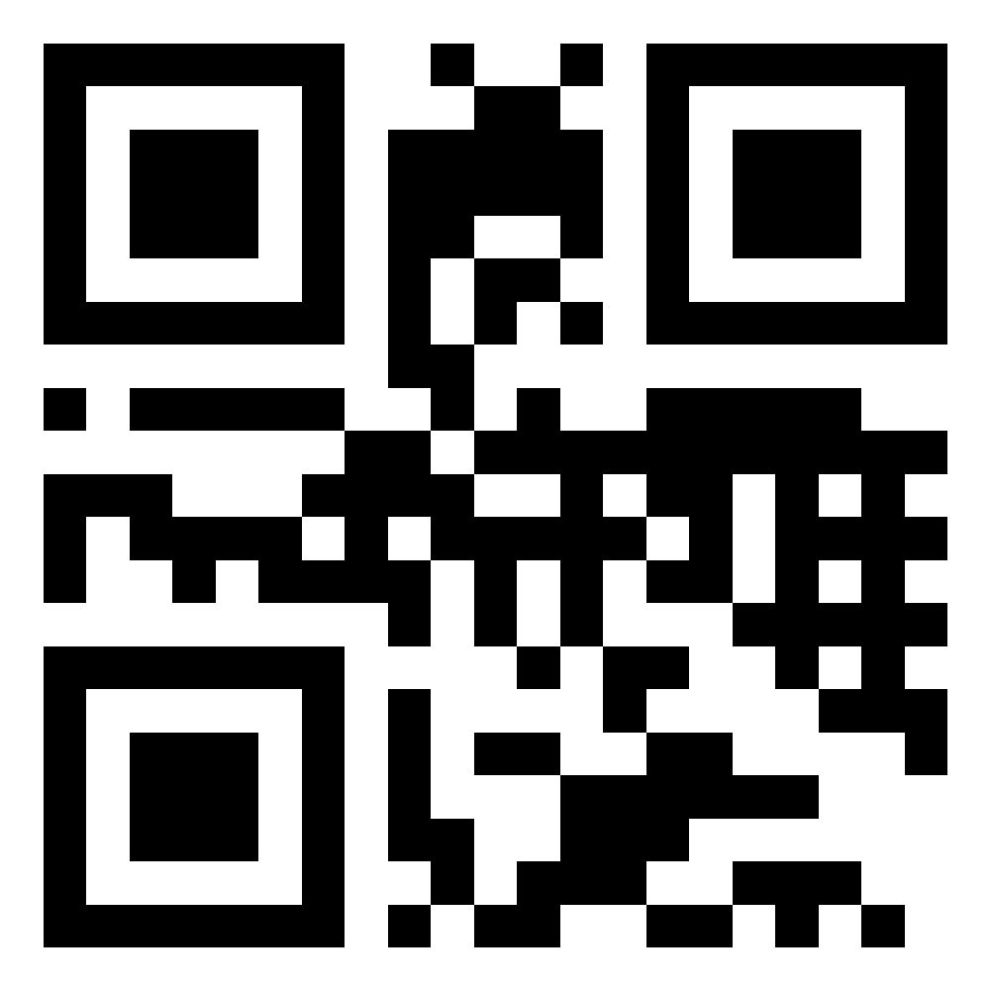
Thank you.
Name
WDF11 PO team
Use the QR code generator to create a QR code for your preferred link.

